Slide 1



Blinkit
Sales Analysis Using SQL
India's Last Minute App

Slide 2
Introduction
Blinkit, formerly known as Grofers, is a leading online grocery delivery service in India. Founded in 2013, it has revolutionized the way people shop for groceries by offering a wide range of products delivered to their doorstep within minutes. With a user-friendly app and website, Blinkit ensures a seamless shopping experience, catering to the needs of busy urban consumers. The company's focus on speed, convenience, and quality has made it a popular choice among customers seeking hassle-free grocery shopping.

Slide 3
Objectives
The key objectives of the analysis are:
To clean and standardize the dataset for consistency
To calculate major KPIs like Total Sales, Average Sales, and Ratings
To uncover patterns based on item type, fat content, outlet type, location, and establishment year

Slide 4
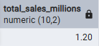
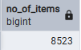
No Of Items
Total Sales

Slide 5
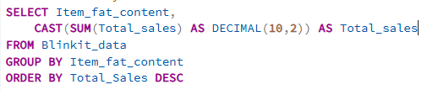
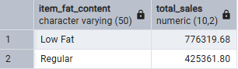
Total Sales by Fat Content

Slide 6
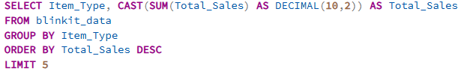
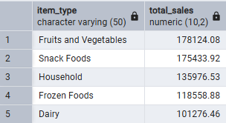
Total Sales by Item Type

Slide 7
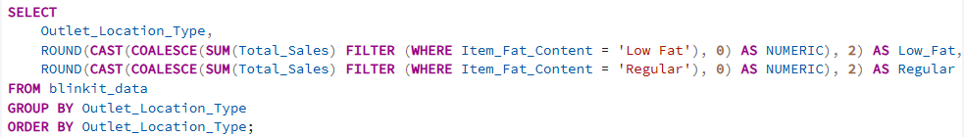
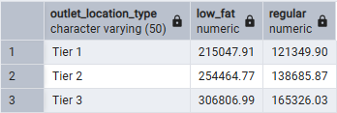
Fat Content By Outlet For Total Sales

Slide 8
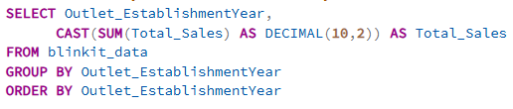
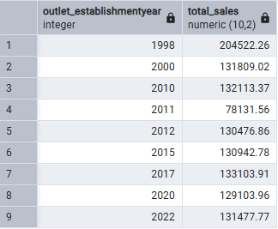
Total Sales By Outlet Establishment

Slide 9
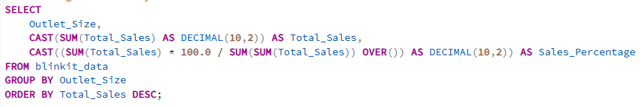
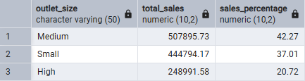
Percentage Of Sales By Outlet Size

Slide 10
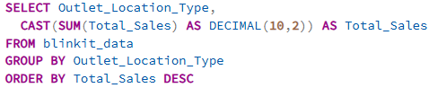
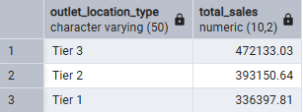
Sales By Outlet Location

Slide 11
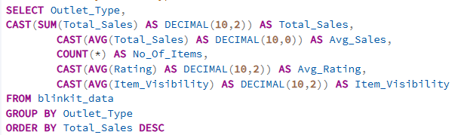
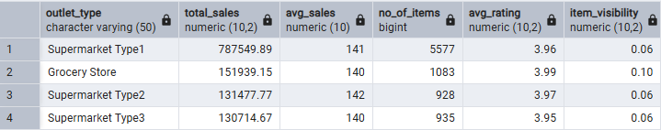
All Metrics By Outlet Type

Slide 12
Conclusion
Data cleaning improved analysis accuracy and consistency.
Low Fat items had higher sales, showing a shift toward health-conscious buying.
Large outlets and Tier 3 locations generated maximum revenue.
Supermarkets led in sales, average rating, and item visibility.
Insights can help Blinkit optimize product mix, outlet expansion, and customer targeting.

Slide 13
Thank You!

